Slide 1


Noida Institute of Engineering and Technology, Greater Noida
Introduction to Data Structure, Arrays, Searching, Sorting & Hashing
UNIT-1
Unit: 1
Data Structures
Dr. Ritesh Rastogi
Associate Professor
Dept. of CSE, M.Tech(Integrated)
(B Tech 3rd Sem)

Slide 2

Faculty Profile
Dr. Ritesh Rastogi (M.Tech,, Ph.D)
(Associate Professor, Dept. of IT, M.Tech (CSE) Integrated
NIET, Greater Noida
Experience : 25 Years (Teaching and Research)
Area of Interest : Software Engg./Testing ,DBMS, Cloud
Honors , Awards and Achievements
Published more than 50 papers in SCI/Scopus/peer reviewed national/international journals and conferences
Authored four books of computer science and a book chapter.
Published and Granted 04 Patents
Guided around 120 PG thesis and projects of M.Tech and MCA Students
Awarded as “Corona Warrior” by Engineering and Management College Teachers Development Association
Research Excellence Award 2020 from Institute of Scholars for research work.
Best Research Paper Award, in ICFCCT 2021 organized by IFERP on 27-28th Oct 2021 Mumbai
Humanitarian Excellence Awards 2021, Certificate of Appreciation by I Can Foundation
Member of professional societies like ISTE, IFERP, C# Corner, Oracle Incorp. IAENG, InSc.
Brand ambassador of IFERP. And Coordinator for IIRS-ISRO Dehra dun.
Member of Editorial board of International Journal.
Dr. Ritesh Rastogi

Slide 3
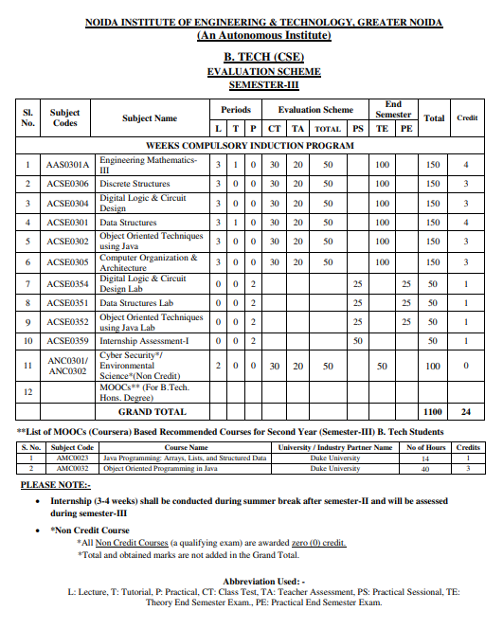
Evaluation Scheme

Slide 4

Unit V Syllabus
Graphs: Terminology used with Graph, Data Structure for Graph Representations: Adjacency matrices, Adjacency List.
Graph Traversal: Depth First Search and Breadth First Search. Connected Component, Spanning Trees, Minimum Cost Spanning Trees: Prim’ s and Kruskal’s algorithm. Transitive Closure and Shortest Path algorithms: Dijkstra Algorithm.
File Structure: Concepts of files, records and files, Sequential, Indexed and Random File Organization, Indexing structure for index files, hashing for direct files, Multi-Key file organization and Access Methods.

Slide 5
Brief Introduction with Video
What is Data Structure?
The data structure name indicates itself that organizing the data in memory. There are many ways of organizing the data in the memory as we have already seen one of the data structures, i.e., array in C language. Array is a collection of memory elements in which data is stored sequentially, i.e., one after another. In other words, we can say that array stores the elements in a continuous manner. This organization of data is done with the help of an array of data structures. There are also other ways to organize the data in memory.
Video Link:
https://www.youtube.com/watch?v=xLetJpcjHS0

Slide 6
Unit Content
Graph Terminology
Graph Representation
Adjacency Matrix
Adjacency List
Minimum Spanning Trees
Prim’s and kruskal’s Algorithm
Graph Traversal
BFS and DFS
Warshal’s Algorithm
Dijkstra Algorithm

Slide 7
Unit Objective
To learn basic Graph Terminology
To study Graph Representation
Adjacency Matrix
Adjacency List
Understand Minimum Spanning Trees
Prim’s and kruskal’s Algorithm
To learn Graph Traversal
BFS and DFS
To study Warshal’s Algorithm and Dijkstra Algorithm

Slide 8
Topic Objective
To learn basic Graph Terminology
To study Graph Representation
Adjacency Matrix
Adjacency List
Understand Minimum Spanning Trees
Prim’s and kruskal’s Algorithm

Slide 9
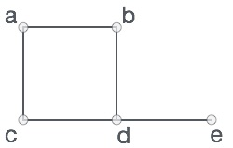
Graphs (CO3)
A graph is a pictorial representation of a set of objects where some pairs of objects are connected by links. The interconnected objects are represented by points termed as vertices, and the links that connect the vertices are called edges.
Formally, a graph is a pair of sets (V, E), where V is the set of vertices and E is the set of edges, connecting the pairs of vertices. Take a look at the following graph −
In the given graph,
V = {a, b, c, d, e}
E = {ab, ac, bd, cd, de}

Slide 10
Graph Terminology
Two vertices joined by an edge are called the end vertices or endpoints of the edge.
If an edge is directed its first endpoint is called the origin and the other is called the destination.
Two vertices are said to be adjacent if they are endpoints of the same edge.
• An edge is said to be incident on a vertex if the vertex is one of the edges endpoints.
The outgoing edges of a vertex are the directed edges whose origin is that vertex.
The incoming edges of a vertex are the directed edges whose destination is that vertex.

Slide 11
Graph Terminology
The total number of edges occurring to a vertex in a graph is its degree.
The out-degree of a vertex in a directed graph is the total number of outgoing edges, whereas the in-degree is the total number of incoming edges.
A vertex with an in-degree of zero is referred to as a source vertex, while one with an out-degree of zero is known as sink vertex.
An isolated vertex is a zero-degree vertex that is not an edge's endpoint.
A path is a set of alternating vertices and edges, with each vertex connected by an edge.
The path that starts and finishes at the same vertex is known as a cycle.
A path with unique vertices is called a simple path.
For each pair of vertices x, y, a graph is strongly connected if it contains a directed path from x to y and a directed path from y to x.

Slide 12
Graph Terminology
A directed graph is weakly connected if all of its directed edges are replaced with undirected edges, resulting in a connected graph. A weakly linked graph's vertices have at least one out-degree or in-degree.
A tree is a connected forest. The primary form of the tree is called a rooted tree, which is a free tree.
A spanning subgraph that is also a tree is known as a spanning tree.
A connected component is the unconnected graph's most connected subgraph.
A bridge, which is an edge of removal, would sever the graph.
Forest is a graph without a cycle.

Slide 13
Graph Terminology (Contd..)
Adjacent, neighbors
Two vertices are adjacent and are neighbors if they are the
endpoints of an edge
Example:
A and B are adjacent
A and D are not adjacent
A
B
C
D

Slide 14
Graph Terminology (Contd..)
Degree: Number of edges incident on a node
A
B
C
D
E
F
The degree of B is 2.

Slide 15
Graph Terminology (Contd..)
Degree (Directed Graphs)
In degree: Number of edges entering a node
Out degree: Number of edges leaving a node
Degree = Indegree + Outdegree
1
2
4
5
The in degree of 2 is 2 and
the out degree of 2 is 3.

Slide 16
Graph Terminology (Contd..)
A path is a sequence of vertices such that there is an edge from each vertex to its successor.
A path is simple if each vertex is distinct.
A circuit is a path in which the terminal vertex coincides with the initial vertex
Simple path: [ 1, 2, 4, 5 ]
Path: [ 1, 2, 4, 5, 4]
Circuit: [ 1, 2, 4, 5, 4, 1]
1
2
3
4
5
6

Slide 17
Graph Terminology (Contd..)
Cycle
A path from a vertex to itself is called a cycle.
A graph is called cyclic if it contains a cycle;
otherwise it is called acyclic
1
2
3
4
5
6
Cycle

Slide 18
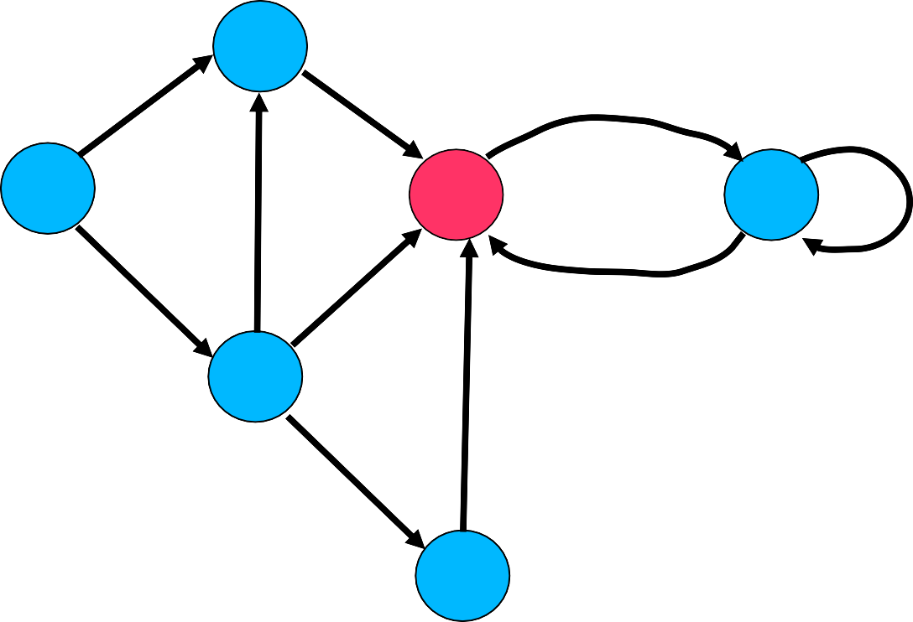
Types of Graph
Directed Graph
A directed graph is one in which every edge (u, v) has a direction, so that (u, v) is different from (v, u)
There are two possible situations that can arise in a directed graph between vertices u and v.
i) only one of (u, v) and (v, u) is present.
ii) both (u, v) and (v, u) are present.
V
a
b
h
U
d
X
Z
e
i
c
W
g
f
Y
Here (u,v) is possible where as (v,u) is not possible
In a directed edge, u is said to be adjacent to v and v is said to be adjacent from u.
j

Slide 19
Types of Graph
Undirected Graph
In an undirected graph, there is no distinction between (u, v) and (v, u).
An edge (u, v) is said to be directed from u to v if the pair (u, v) is ordered with u preceding v.
E.g. A Flight Route
An edge (u, v) is said to be undirected if the pair (u, v) is not ordered
E.g. Road Map
a
B
b
h
A
D
F
e
i
j
c
C
g
f
E
Here (u,v) and (v,u) both are possible.

Slide 20
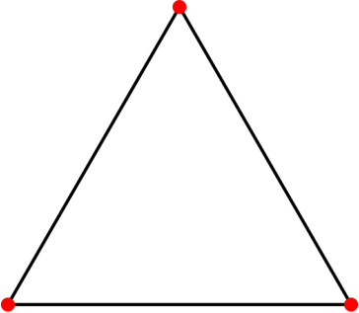
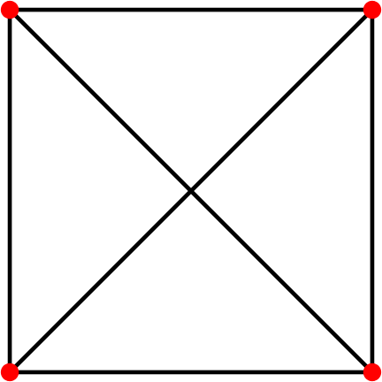
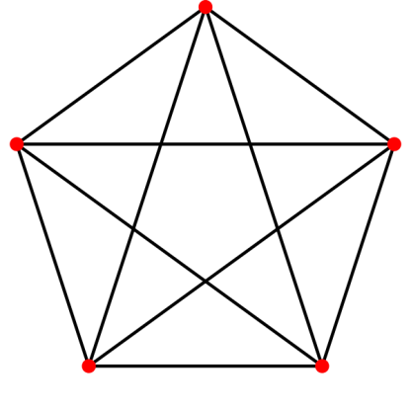
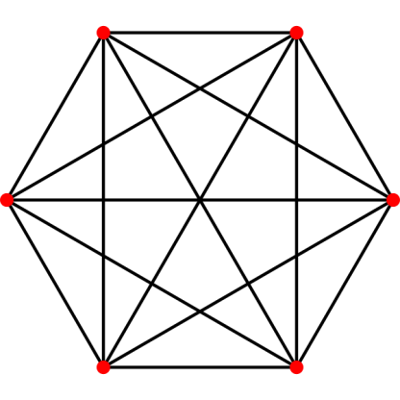
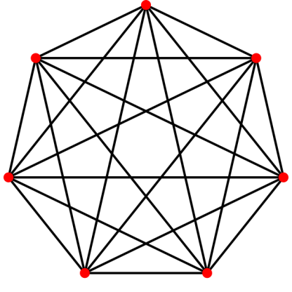
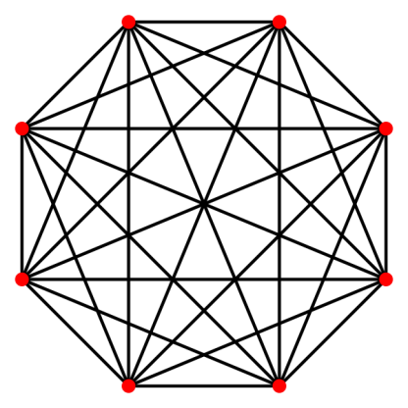
Types of Graph
Complete Graph
Complete Graph: A simple graph in which every pair of vertices are adjacent
If no of vertices = n, then there are n(n-1)/2 edges

Slide 21
Types of Graph
Weighted Graph Weighted graph is a graph for which each edge has an associated weight, usually given by a weight function w: E ® R
2
1
2
3
5
3
1
4
5
6

Slide 22
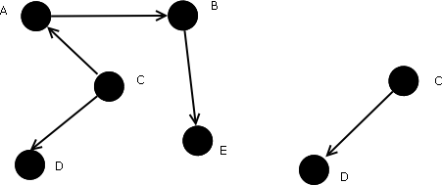
Types of Graph
Subgraph
A graph whose vertices and edges are subsets of another graph.
A subgraph G’=(V’,E’) of a graph G = (V,E) such that V’ ⊆ V and E’ ⊆ E , Then G is a supergraph for G’.
(G) (G1)

Slide 23
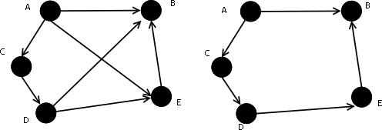
Types of Graph
Spanning Subgraph
A spanning subgraph is a subgraph that contains all the vertices of the original graph.

Slide 24
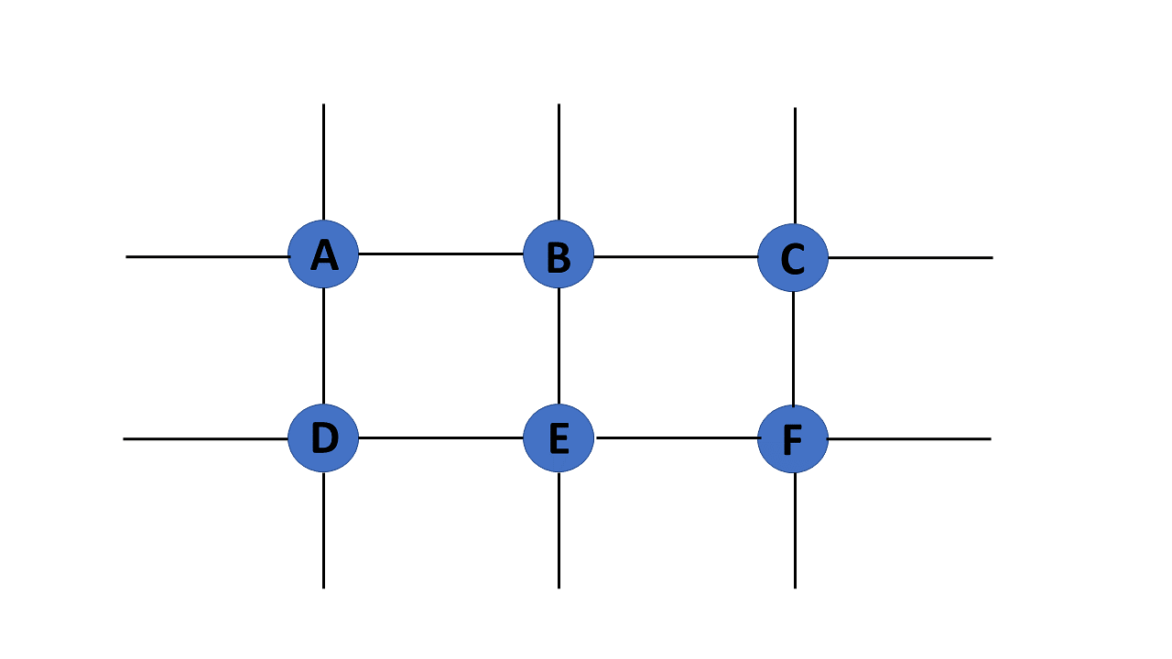
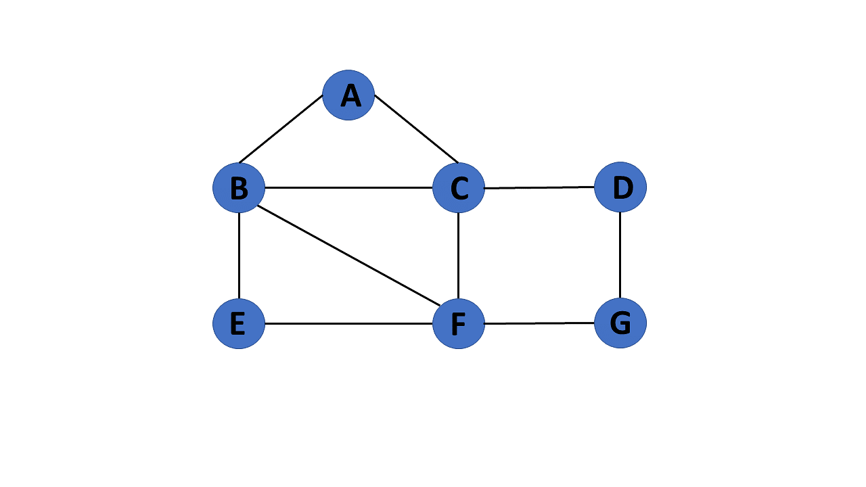
Types of Graph
Finite Graph
The graph G=(V, E) is called a finite graph if the number of vertices and edges in the graph is limited in number
Infinite Graph
The graph G=(V, E) is called a finite graph if the number of vertices and edges in the graph is interminable.

Slide 25

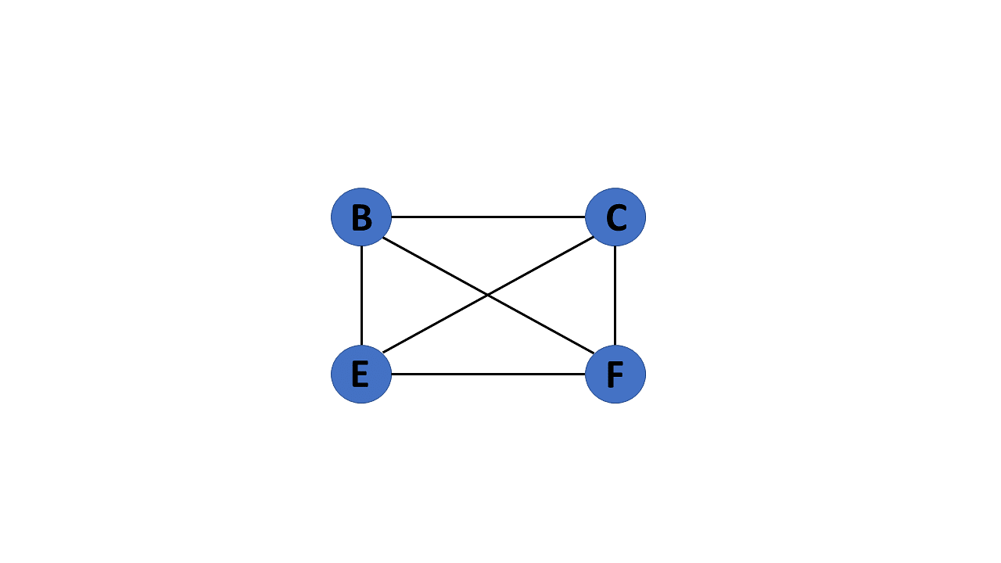
Types of Graph
Trivial Graph
A graph G= (V, E) is trivial if it contains only a single vertex and no edges.
Simple Graph
If each pair of nodes or vertices in a graph G=(V, E) has only one edge, it is a simple graph. As a result, there is just one edge linking two vertices, depicting one-to-one interactions between two elements

Slide 26
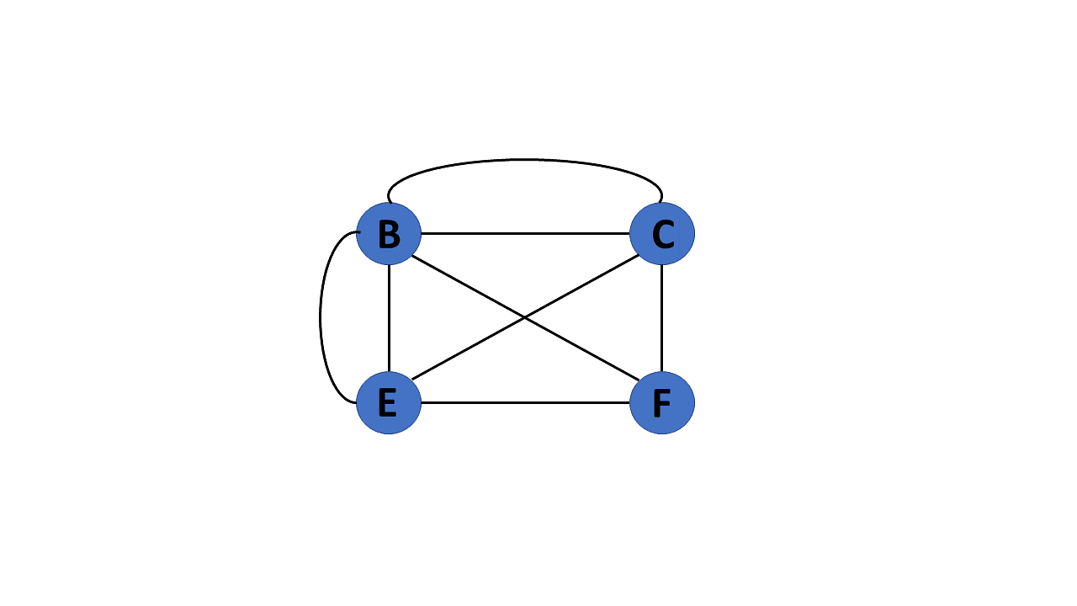
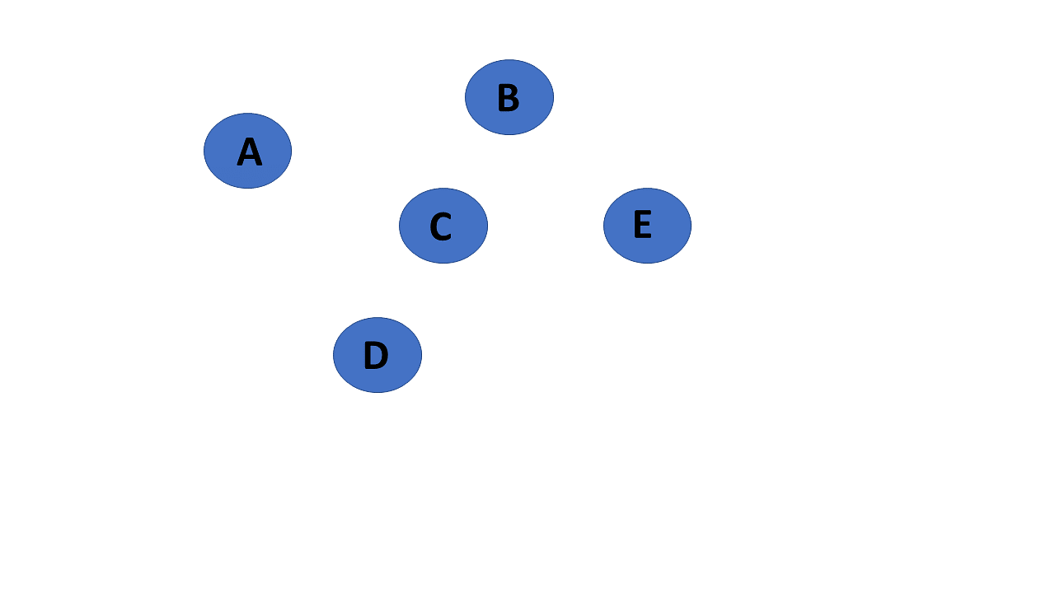
Types of Graph
Null Graph
It's a reworked version of a trivial graph. If several vertices but no edges connect them, a graph G= (V, E) is a null graph.
Multi Graph
If there are numerous edges between a pair of vertices in a graph G= (V, E), the graph is referred to as a multigraph. There are no self-loops in a Multigraph

Slide 27
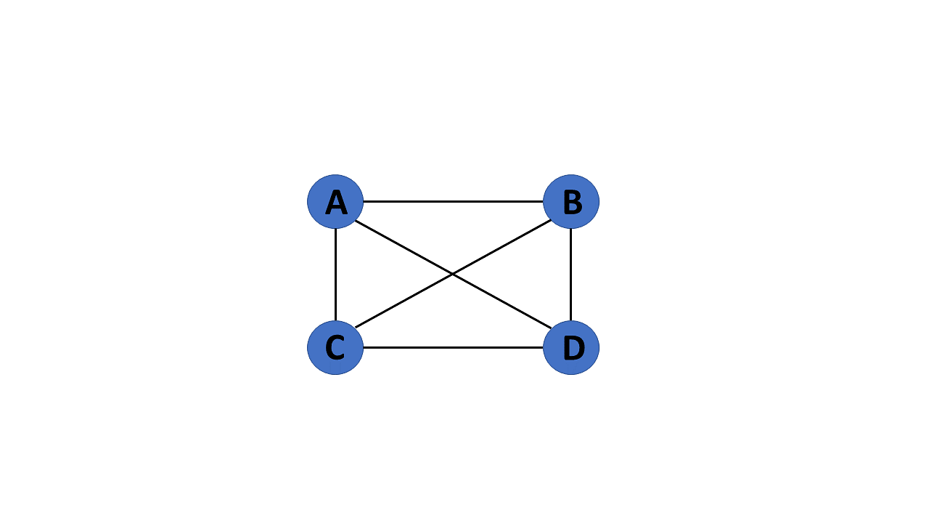
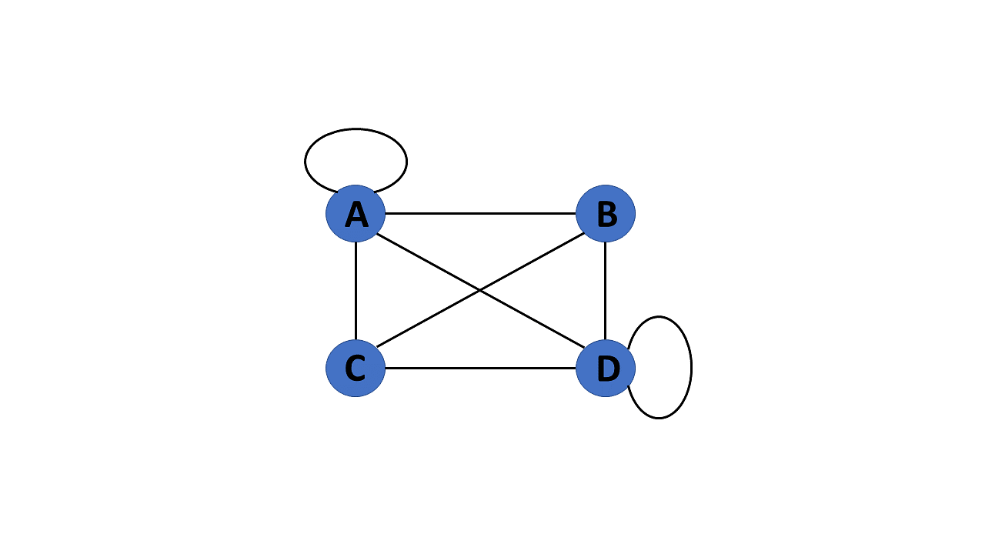
Types of Graph
Complete Graph
If a graph G= (V, E) is also a simple graph, it is complete. Using the edges, with n number of vertices must be connected. It's also known as a full graph because each vertex's degree must be n-1.
Pseudo Graph
If a graph G= (V, E) contains a self-loop besides other edges, it is a pseudo graph

Slide 28
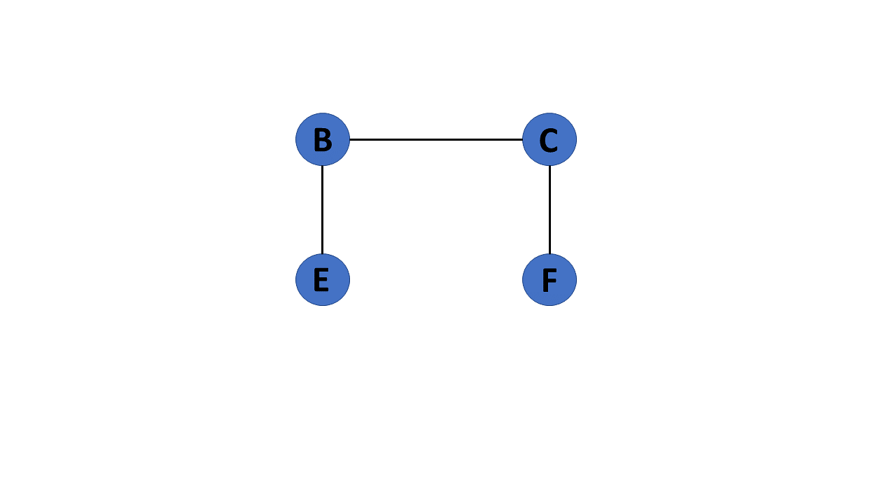
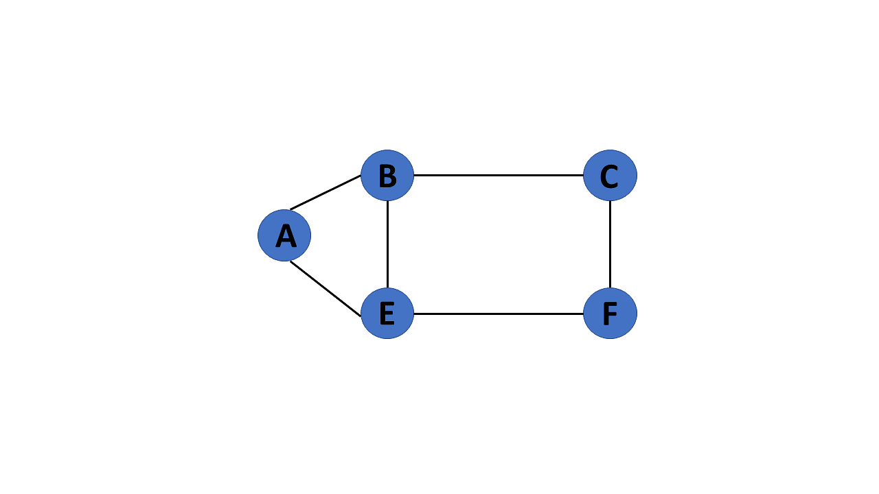
Types of Graph
Cyclic Graph
If a graph contains at least one graph cycle, it is considered to be cyclic.
Acyclic Graph
When there are no cycles in a graph, it is called an acyclic graph.

Slide 29
Graph Representation
Adjacency Matrix
Incidence Matrix
Adjacency List

Slide 30
Graph Representation
Adjacency, Incidence, and Degree
Assume e_{i} is an edge whose endpoints are (v_{j},v_{k})
The vertices v_{j} and vk are said to be adjacent
The edge ei is said to be incident upon v_{j}
Degree of a vertex v_{k} is the number of edges incident upon v_{k} . It is denoted as d(v_{k})
vj v_{k}
e_{i}

Slide 31
Adjacency Matrix
Let G = (V, E), |V| = n and |E|=m
The adjacency matrix of G written A(G), is the |V| x |E| matrix in which entry a_{i,j} is 1 if an edge exists otherwise it is 0
 | 1 | 2 | 3 | 4 | 5
1 | 0 | 1 | 0 | 0 | 1
2 | 1 | 0 | 1 | 1 | 1
3 | 0 | 1 | 0 | 1 | 0
4 | 0 | 1 | 1 | 0 | 1
5 | 1 | 1 | 0 | 1 | 0
1
2
3
5
4

Slide 32
Adjacency Matrix (Weighted Graph)
Let G = (V, E), |V| = n and |E|=m
The adjacency matrix of G written A(G), is the |V| x |E| matrix in which entry a_{i,j} is weight of the edge if it exists otherwise it is 0
 | 1 | 2 | 3 | 4 | 5
1 | 0 | 5 | 0 | 0 | 1
2 | 5 | 0 | 4 | 6 | 3
3 | 0 | 4 | 0 | 2 | 0
4 | 0 | 6 | 2 | 0 | 7
5 | 1 | 3 | 0 | 7 | 0
1
1
5
5
2
6
4
4
3
3
2
7

Slide 33
Adjacency List
Adjacency-list representation
an array of |V | elements, one for each vertex in V
For each u in V , ADJ [ u ] points to all its adjacent vertices.
1
2
3
4
5
2
5
1
2
5
3
4
3
4
5
4
5
5

Slide 34
Spanning Trees
A spanning tree of a graph is just a subgraph that contains all the vertices and is a tree.
A graph may have many spanning trees.
Graph A Some Spanning Trees from Graph A

Slide 35
Spanning Trees
Complete Graph All 16 of its Spanning Trees

Slide 36
Minimum Spanning Trees- MST
The Minimum Spanning Tree for a given graph is the Spanning Tree of minimum cost for that graph.
Complete Graph Minimum Spanning Tree
7
2
2
5
3
3
4
1
1

Slide 37
MST Algorithms
Kruskal Algorithm
Prim’s Algorithm

Slide 38
Kruskal’s Algorithm
Kruskal's algorithm is a minimum spanning tree algorithm that takes a graph as input and finds the subset of the edges of that graph which
form a tree that includes every vertex
has the minimum sum of weights among all the trees that can be formed from the graph

Slide 39
Kruskal’s Algorithm Working
We start from the edges with the lowest weight and keep adding edges until we we reach our goal.
The steps for implementing Kruskal's algorithm are as follows:
Sort all the edges from low weight to high
Take the edge with the lowest weight and add it to the spanning tree. If adding the edge created a cycle, then reject this edge.
Keep adding edges until we reach all vertices.

Slide 40
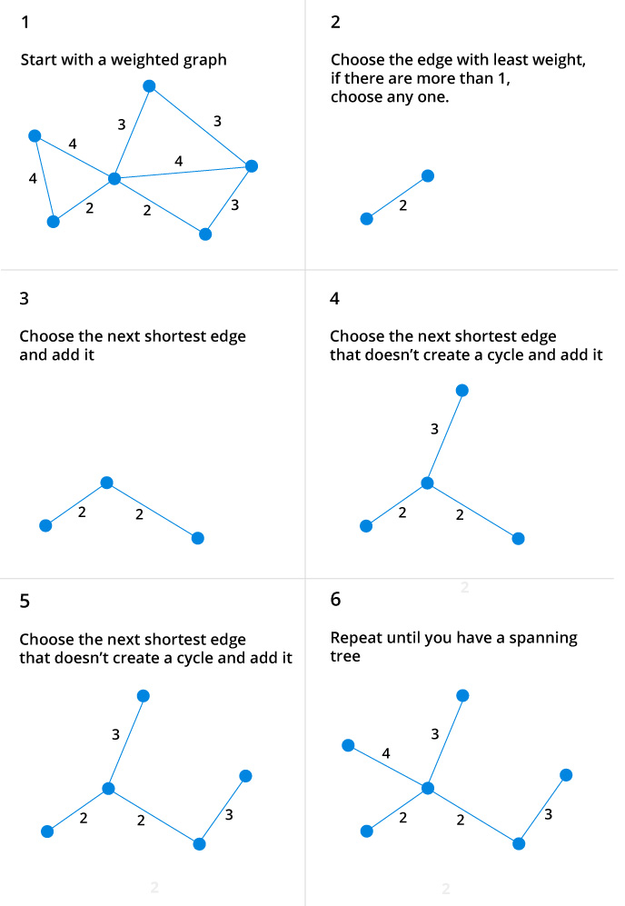
Kruskal’s Algorithm Example -01

Slide 41
Kruskal’s Algorithm Example-02
List the edges in order of size:
ED 2
AB 3
AE 4
CD 4
BC 5
EF 5
CF 6
AF 7
BF 8
DF 8
B
5
C
3
6
4
8
8
A
F
D
7
5
4
2
E

Slide 42
Kruskal’s Algorithm Example-02
B
5
C
Select the shortest
edge in the network
ED 2
3
6
4
8
8
A
F
D
7
5
4
2
E

Slide 43
Kruskal’s Algorithm Example-02
Select the shortest
edge in the network
ED 2
AB 3
B
5
C
3
6
4
8
8
A
F
D
7
5
4
2
E

Slide 44
Kruskal’s Algorithm Example-02
Select the shortest
edge in the network
ED 2
AB 3
CD 4( or AE 4)
B
5
C
3
6
4
8
8
A
F
D
7
5
4
2
E

Slide 45
Kruskal’s Algorithm Example-02
Select the shortest
edge in the network
ED 2
AB 3
CD 4( or AE 4)
AE 4
B
5
C
3
6
4
8
8
A
F
D
7
5
4
2
E

Slide 46
Kruskal’s Algorithm Example-02
Select the shortest
edge in the network
ED 2
AB 3
CD 4( or AE 4)
AE 4
BC FORMS A CYCLE
EF 5
B
5
C
3
6
4
8
8
A
F
D
7
5
4
2
E

Slide 47
Kruskal’s Algorithm Example-02
Select the shortest
edge in the network
ED 2
AB 3
CD 4( or AE 4)
AE 4
BC FORMS A CYCLE
EF 5
Total Weight of Tree = 18
B
5
C
3
6
4
8
8
A
F
D
7
5
4
2
E

Slide 48
Prim’s Algorithm
Prim’s Algorithm-
Prim’s Algorithm is a famous greedy algorithm.
It is used for finding the Minimum Spanning Tree (MST) of a given graph.
To apply Prim’s algorithm, the given graph must be weighted, connected and undirected.

Slide 49
Prim’s Algorithm
Prim’s Algorithm
Step-01:
Randomly choose any vertex.
The vertex connecting to the edge having least weight is usually selected.
Step-02:
Find all the edges that connect the tree to new vertices.
Find the least weight edge among those edges and include it in the existing tree.
If including that edge creates a cycle, then reject that edge and look for the next least weight edge.
Step-03:
Keep repeating step-02 until all the vertices are included and Minimum Spanning Tree (MST) is obtained.

Slide 50

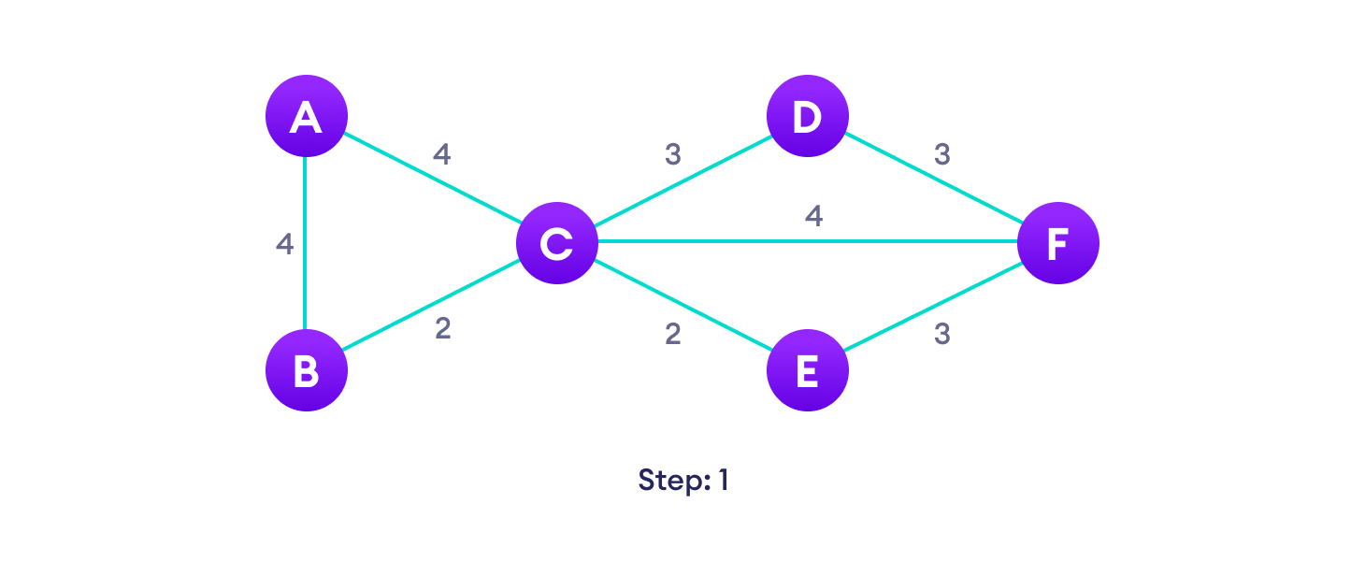


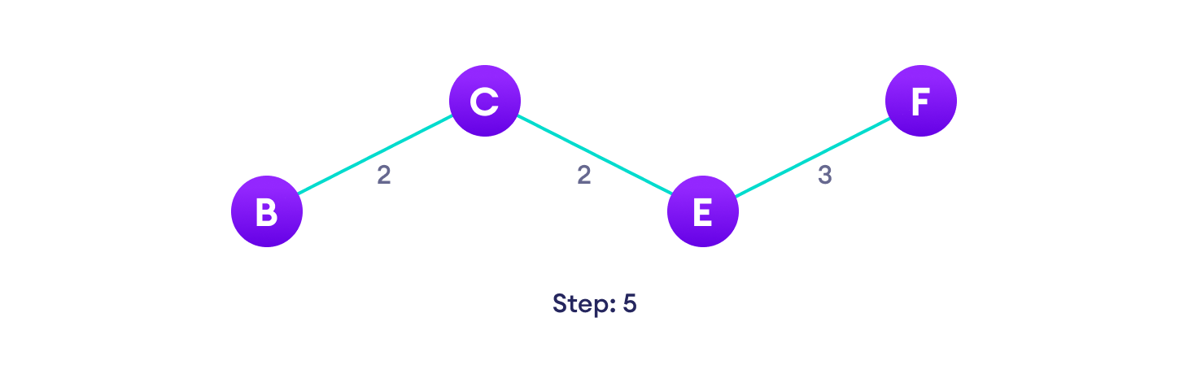
Prim’s Algorithm Example-01

Slide 51
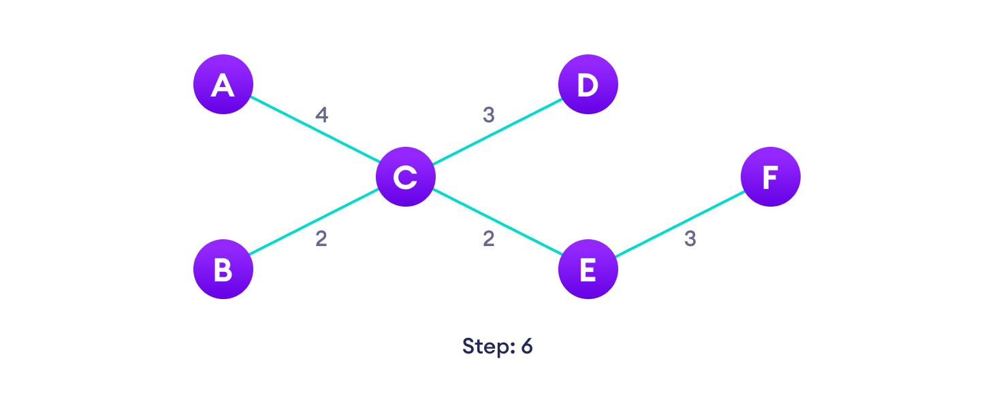
Prim’s Algorithm Example -01

Slide 52
Prism’s Algorithm Example-02
Select any vertex
A
Select the shortest edge connected to that vertex
AB 3
B
5
C
3
6
4
8
8
A
F
D
7
5
4
2
E

Slide 53
Prism’s Algorithm Example-02
B
5
Select the shortest
edge connected to
any vertex already
connected.
AE 4
C
3
6
4
8
8
A
F
D
7
5
4
2
E

Slide 54
Prism’s Algorithm Example-02
Select the shortest
edge connected to
any vertex already
connected.
ED 2
B
5
C
3
6
4
8
8
A
F
D
7
5
4
2
E

Slide 55
Prism’s Algorithm Example-02
B
5
C
Select the shortest
edge connected to
any vertex already
connected.
DC 4
3
6
4
8
8
A
F
D
7
5
4
2
E

Slide 56
Prism’s Algorithm Example-02
B
5
C
3
Select the shortest
edge connected to
any vertex already
connected.
EF 5
6
4
8
8
A
F
D
7
5
4
2
E

Slide 57
Prism’s Algorithm Example-02
All vertices have been
connected.
The solution is
AB 3
AE 4
ED 2
DC 4
EF 5
Total weight of tree is 18
B
5
C
3
4
8
6
8
A
D
7
F
5
4
2
E

Slide 58
Difference Between Kruskal’s and Prim’s Algorithm.
Kruskal’s algorithm
Select the shortest edge in a network
Select the next shortest edge which does not create a cycle
Repeat step 2 until all vertices have been connected
Prism algorithm
Select any vertex
Select the shortest edge connected to that vertex
Select the shortest edge connected to any vertex already connected
Repeat step 3 until all vertices have been connected

Slide 59
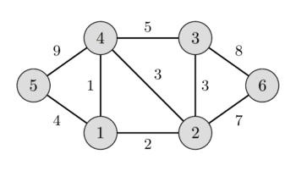
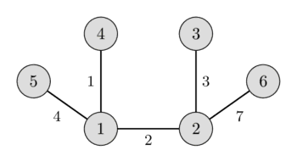
Prim’s Algorithm Exercise

Slide 60
Prim’s Algorithm
https://www.programiz.com/dsa/prim-algorithm
https://www.youtube.com/watch?v=ZtZaR7EcI5Y

Slide 61
Daily Quiz
Which of the following is false in the case of a spanning tree of a graph G? a) It is tree that spans G b) It is a subgraph of the G c) It includes every vertex of the G d) It can be either cyclic or acyclic
Consider a complete graph G with 4 vertices. The graph G has ____ spanning trees. a) 15 b) 8 c) 16 d) 13

Slide 62
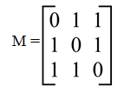
Daily Quiz
3. Consider the graph M with 3 vertices. Its adjacency matrix is shown below. Which of the following is true?
a) Graph M has no minimum spanning tree b) Graph M has a unique minimum spanning trees of cost 2 c) Graph M has 3 distinct minimum spanning trees, each of cost 2 d) Graph M has 3 spanning trees of different costs
4. The travelling salesman problem can be solved using ________
a) spanning tree
b) A minimum spanning tree
c ) Bellman – Ford algorithm
d) DFS traversal

Slide 63
Topic Objective
Operations on Graph
To learn Graph Traversal
BFS and DFS
To study Warshal’s Algorithm and Dijkstra Algorithm

Slide 64
Operations on Graph
The operations you perform on the graphs in data structures are listed below:
Creating graphs
Insert vertex
Delete vertex
Insert edge
Delete edge

Slide 65
Operations on Graph
Creating Graphs
There are two techniques to make a graph:
Adjacency Matrix
The adjacency matrix of a simple labeled graph, also known as the connection matrix, is a matrix with rows and columns labeled by graph vertices and a 1 or 0 in position depending on whether they are adjacent or not.
Adjacency List
A finite graph is represented by an adjacency list, which is a collection of unordered lists. Each unordered list describes the set of neighbors of a particular vertex in the graph within an adjacency list.

Slide 66
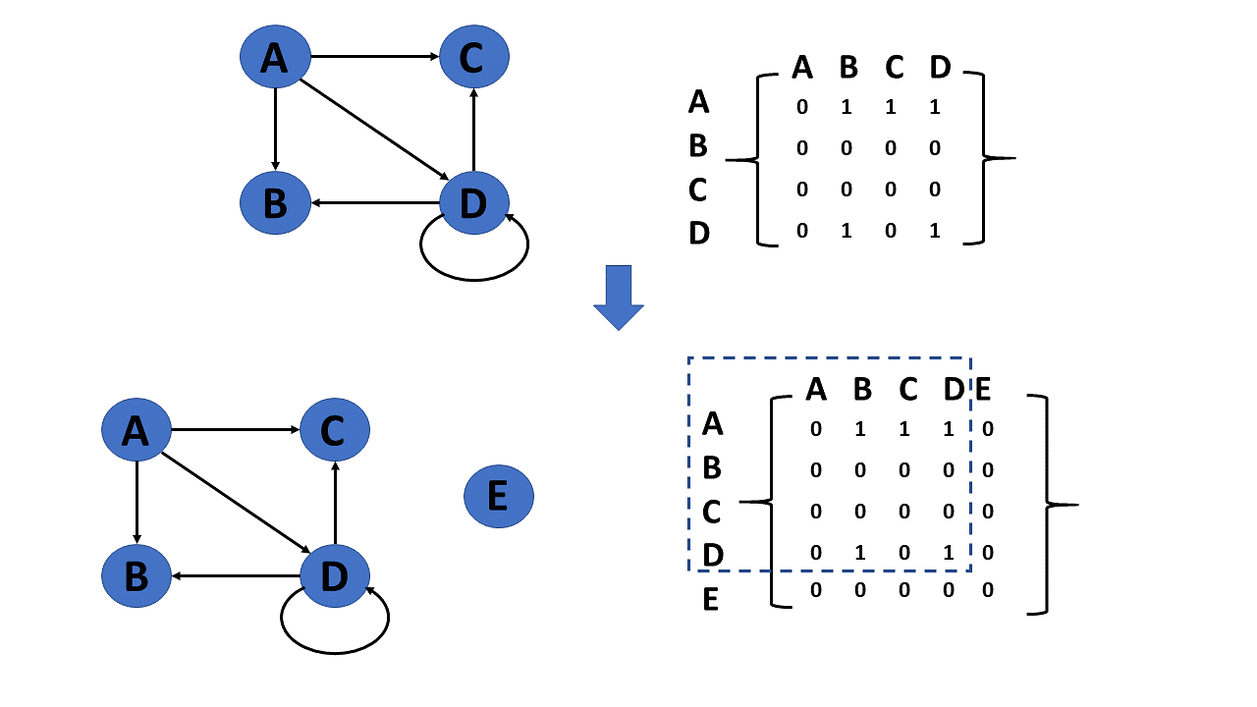
Operations on Graph
Insert Vertex
When you add a vertex that after introducing one or more vertices or nodes, the graph's size grows by one, increasing the matrix's size by one at the row and column levels.

Slide 67
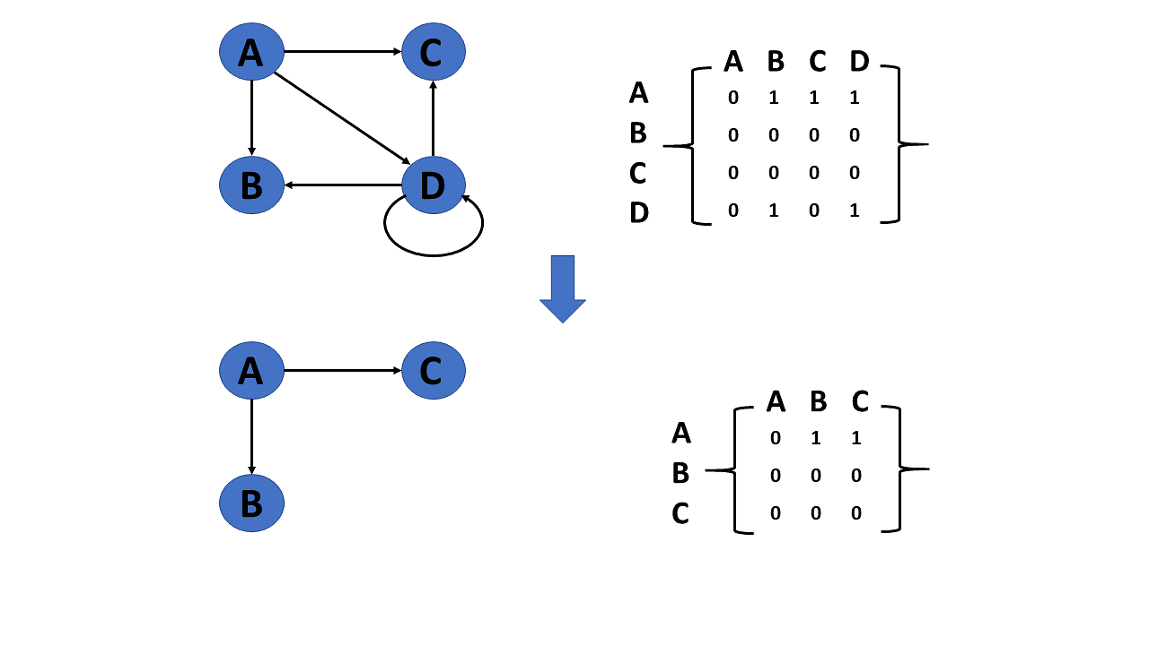
Operations on Graph
Delete Vertex
Deleting a vertex refers to removing a specific node or vertex from a graph that has been saved.
If a removed node appears in the graph, the matrix returns that node. If a deleted node does not appear in the graph, the matrix returns the node not available.

Slide 68
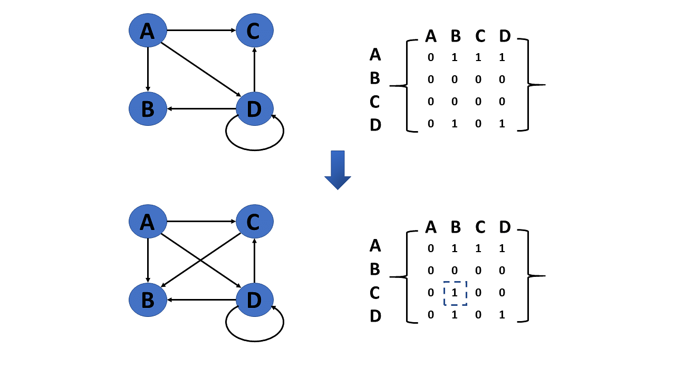
Operations on Graph
Insert Edge
Connecting two provided vertices can be used to add an edge to a graph.

Slide 69
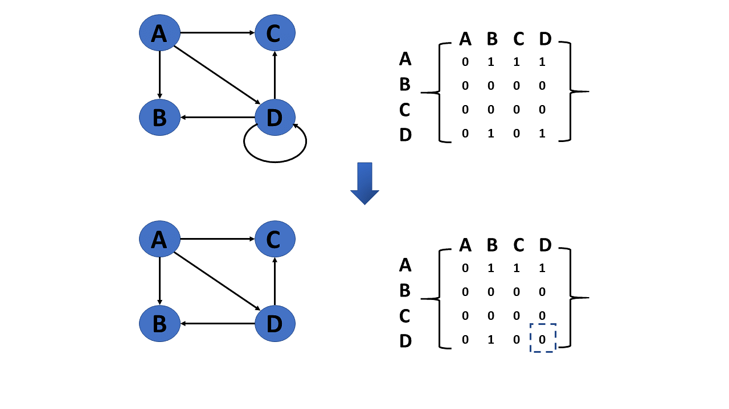
Operations on Graph
Delete Edge
The connection between the vertices or nodes can be removed to delete an edge.

Slide 70
Graph Traversal (CO3)
Graph traversal is a technique used for a searching vertex in a graph.
The graph traversal is also used to decide the order of vertices is visited in the search process.
A graph traversal finds the edges to be used in the search process without creating loops.
That means using graph traversal we visit all the vertices of the graph without getting into looping path.
There are two graph traversal techniques and they are as follows...
DFS (Depth First Search)
BFS (Breadth First Search)

Slide 71
Graph Traversal (CO3)
Depth First Search (DFS)
Depth First Search or DFS is a graph traversal algorithm.
It is used for traversing or searching a graph in a systematic fashion.
DFS uses a strategy that searches “deeper” in the graph whenever possible.
Stack data structure is used in the implementation of depth first search.

Slide 72
Graph Traversal
Depth First Search Algorithm
A standard DFS implementation puts each vertex of the graph into one of two categories:
Visited
Not Visited
The purpose of the algorithm is to mark each vertex as visited while avoiding cycles.
The DFS algorithm works as follows:
Start by putting any one of the graph's vertices on top of a stack.
Take the top item of the stack and add it to the visited list.
Create a list of that vertex's adjacent nodes. Add the ones which aren't in the visited list to the top of the stack.
Keep repeating steps 2 and 3 until the stack is empty.

Slide 73
Depth First Search
Depth First Search Algorithm
A standard DFS implementation puts each vertex of the graph into one of two categories:
Visited
Not Visited
The purpose of the algorithm is to mark each vertex as visited while avoiding cycles.
The DFS algorithm works as follows:
Start by putting any one of the graph's vertices on top of a stack.
Take the top item of the stack and add it to the visited list.
Create a list of that vertex's adjacent nodes. Add the ones which aren't in the visited list to the top of the stack.
Keep repeating steps 2 and 3 until the stack is empty.

Slide 74
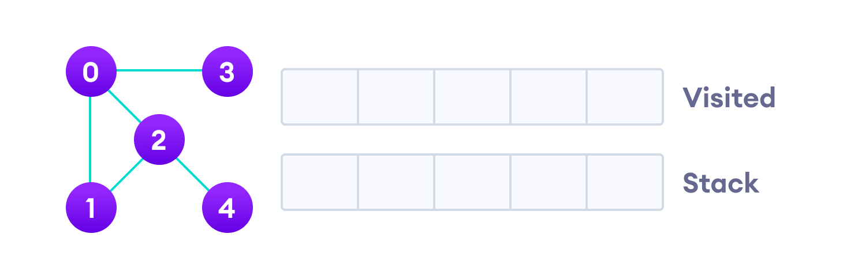
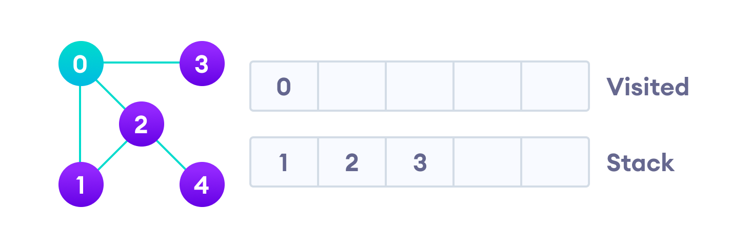
Depth First Search
Depth First Search Example

Slide 75
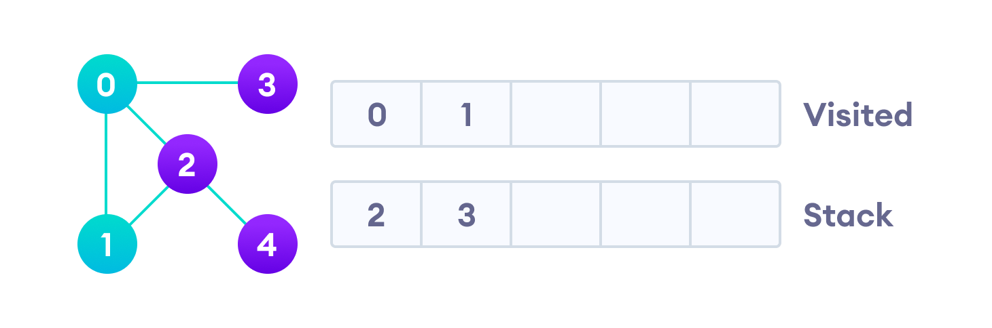
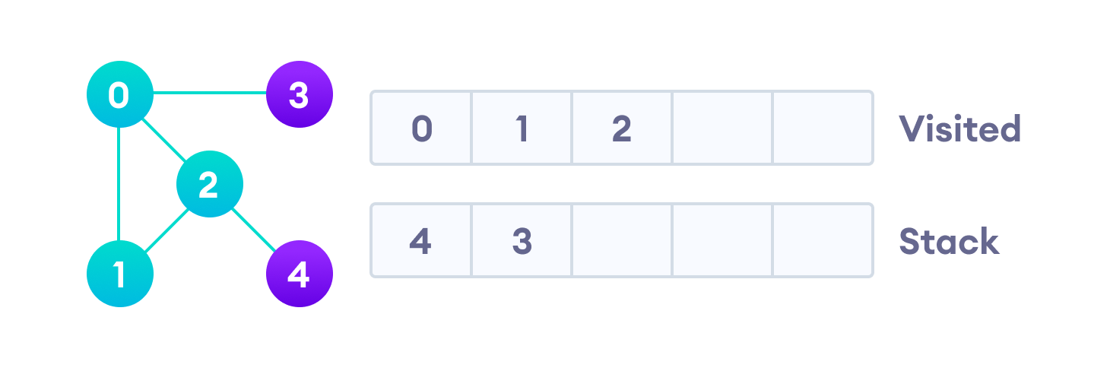
Depth First Search
Depth First Search Example

Slide 76
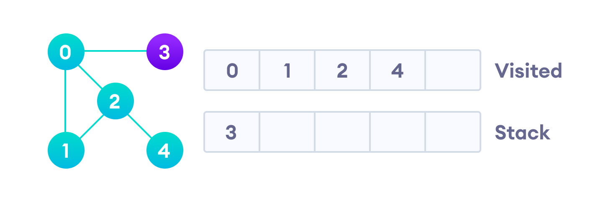
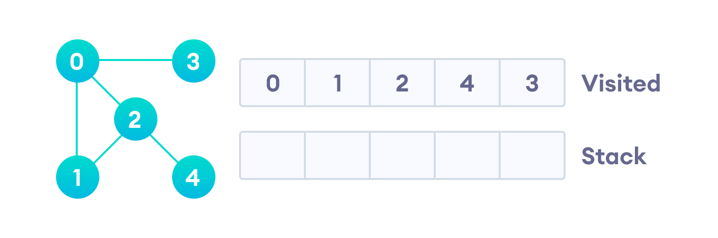
Depth First Search
Depth First Search Example

Slide 77
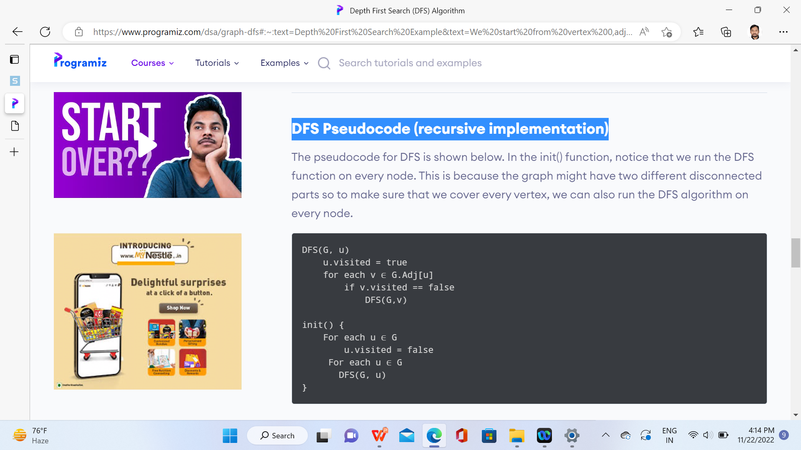
Depth First Search
DFS Pseudocode (recursive implementation)

Slide 78
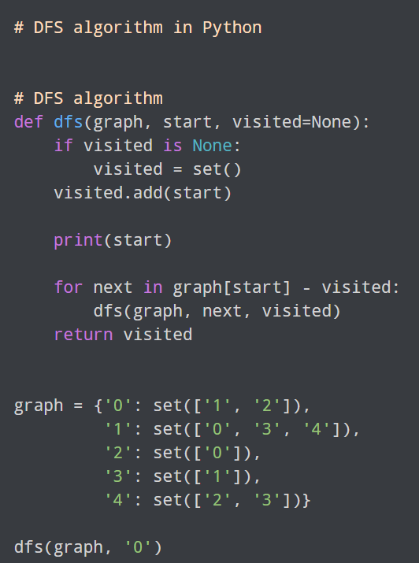
Depth First Search

Slide 79
Depth First Search
Complexity of Depth First Search
The time complexity of the DFS algorithm is represented in the form of O(V + E), where V is the number of nodes and E is the number of edges.
The space complexity of the algorithm is O(V).
Application of DFS Algorithm
For finding the path
To test if the graph is bipartite
For finding the strongly connected components of a graph
For detecting cycles in a graph

Slide 80
Breadth First Search
Breadth-first search (BFS)
Breadth-first search (BFS) is an algorithm that is used to graph data or searching tree or traversing structures.
This algorithm selects a single node (initial or source point) in a graph and then visits all the nodes adjacent to the selected node.
BFS accesses these nodes one by one.
Once the algorithm visits and marks the starting node, then it moves towards the nearest unvisited nodes and analyses them. Once visited, all nodes are marked.
These iterations continue until all the nodes of the graph have been successfully visited and marked.

Slide 81
Breadth First Search
Why do we need BFS Algorithm?
BFS is useful for analyzing the nodes in a graph and constructing the shortest path of traversing through these.
BFS can traverse through a graph in the smallest number of iterations.
The architecture of the BFS algorithm is simple and robust.
The result of the BFS algorithm holds a high level of accuracy in comparison to other algorithms.
BFS iterations are seamless, and there is no possibility of this algorithm getting caught up in an infinite loop problem.

Slide 82
Breadth First Search
Rules of BFS Algorithm
A queue (FIFO-First in First Out) data structure is used by BFS.
You mark any node in the graph as root and start traversing the data from it.
BFS traverses all the nodes in the graph and keeps dropping them as completed.
BFS visits an adjacent unvisited node, marks it as done, and inserts it into a queue.
Removes the previous vertex from the queue in case no adjacent vertex is found.
BFS algorithm iterates until all the vertices in the graph are successfully traversed and marked as completed.
There are no loops caused by BFS during the traversing of data from any node.

Slide 83
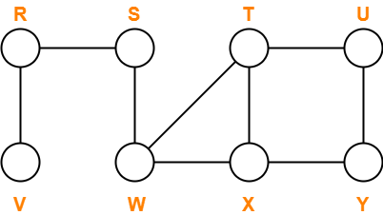
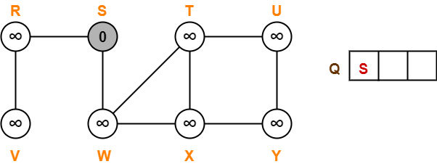
Breadth First Search
BFS Example: Starting Node = S

Slide 84
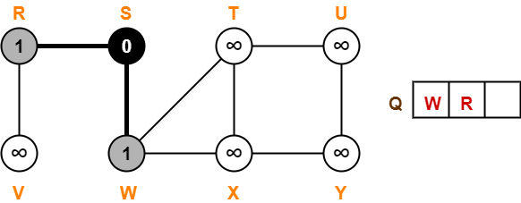
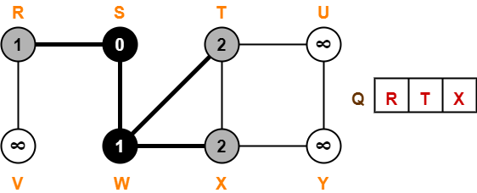
Breadth First Search
BFS Example: Starting Node = S

Slide 85
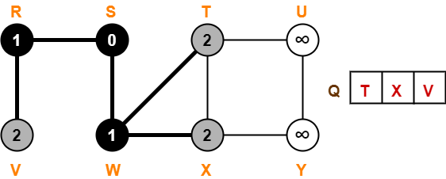
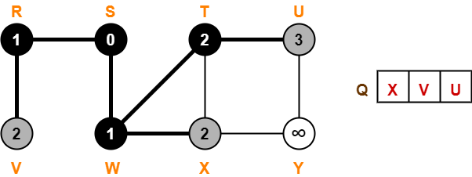
Breadth First Search
BFS Example: Starting Node = S

Slide 86
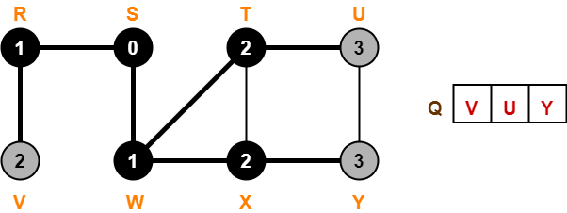
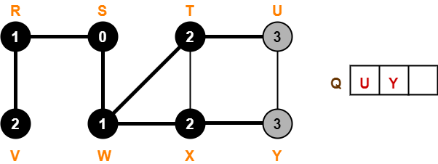
Breadth First Search
BFS Example: Starting Node = S

Slide 87
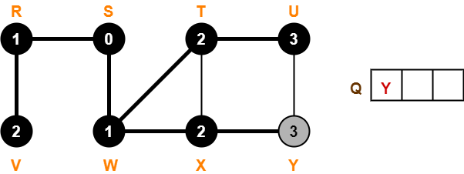
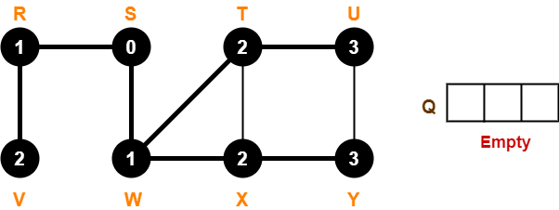
Breadth First Search
BFS Example: Starting Node = S

Slide 88
Breadth First Search
Applications of BFS Algorithm
Un-weighted Graphs: BFS algorithm can easily create the shortest path and a minimum spanning tree to visit all the vertices of the graph in the shortest time possible with high accuracy.
P2P Networks: BFS can be implemented to locate all the nearest or neighboring nodes in a peer to peer network. This will find the required data faster.
Web Crawlers: Search engines or web crawlers can easily build multiple levels of indexes by employing BFS. BFS implementation starts from the source, which is the web page, and then it visits all the links from that source.
Navigation Systems: BFS can help find all the neighboring locations from the main or source location.
Network Broadcasting: A broadcasted packet is guided by the BFS algorithm to find and reach all the nodes it has the address for.

Slide 89
DFS & BFS
DFS (Depth First Search)
https://www.tutorialspoint.com/data_structures_algorithms/depth_first_traversal.htm#:~:text=Depth%20First%20Search%20(DFS)%20algorithm,F%20and%20lastly%20to%20C.
BFS (Breadth First Search)
https://www.tutorialspoint.com/data_structures_algorithms/breadth_first_traversal.htm

Slide 90
Dijkstra's Algorithm
Dijkstra's Algorithm
Dijkstra's algorithm allows us to find the shortest path between any two vertices of a graph.
It differs from the minimum spanning tree because the shortest distance between two vertices might not include all the vertices of the graph.
https://www.programiz.com/dsa/dijkstra-algorithm

Slide 91
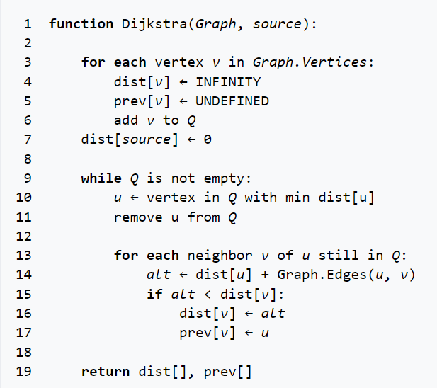
Dijkstra's Algorithm
Dijkstra's Algorithm

Slide 92

Dijkstra's Algorithm
Dijkstra's Algorithm
8
formula for calculating the distance between the vertices:
if( d(u) + c(u, v) < d(v)):
d(v) = d(u) +c(u, v)

Slide 93

Dijkstra's Algorithm
Dijkstra's Algorithm
Calculating the distance between u = 0 and v = 1 the vertices:
d(1) = infinity
d(0) = 0, c(0,1) = 4
if( d(0) + c(0, 1) < d(1)):
d(1) = d(0) +c(0, 1) = 0 + 4 = 4

Slide 94

Dijkstra's Algorithm
Dijkstra's Algorithm

Slide 95

Dijkstra's Example

Slide 96

Dijkstra's Example

Slide 97

Dijkstra's Example

Slide 98

Dijkstra's Example

Slide 99

Dijkstra's Example

Slide 100

Dijkstra's Example

Slide 101

Dijkstra's Example

Slide 102

Dijkstra's Example

Slide 103

Dijkstra's Example

Slide 104

Dijkstra's Example

Slide 105
Dijkstra's Example

Slide 106
Warshal’s Algorithm (CO3)
https://www.programiz.com/dsa/floyd-warshall-algorithm

Slide 107
Dijkstra’s Algorithm (CO3)
https://www.programiz.com/dsa/dijkstra-algorithm

Slide 108
Daily Quiz
1. Dijkstra’s Algorithm is used to solve _____________ problems. a) All pair shortest path b) Single source shortest path c) Network flow d) Sorting
2. . What is the time complexity of Dijikstra’s algorithm? a) O(N) b) O(N³) c) O(N²) d) O(logN)

Slide 109

Daily Quiz
3. Consider the following graph.
If b is the source vertex, what is the minimum cost to reach f vertex? a) 8 b) 9 c) 4 d) 6

Slide 110
Weekly Assignment
What is Graph data structure and write its terminologies
What are the various representation of a graph
Write the BFS algorithm
Write the DFS algorithm
Write the Dijkstra’s shortest path algorithm
Write the Warshal’s Shortest path algorithm
Write the Prim’s algorithm
Write the Krushal’s algorithm

Slide 111
CHP - 9 File Structures
File Structure

Slide 112
Prerequisite and Recap
Prerequisite
Knowledge of
Algorithms
C Language
Data Structure Concepts.
Recap
Studied about
Graphs and their algorithm

Slide 113
Content
Physical Storage
Files

Slide 114
Topic Objective
Students will get to understand about the important concept of Files

Slide 115
Physical Storage Media(CO3)
Classification of Physical Storage Media
Main criteria:
Speed with which data can be accessed and cost per unit of data to buy medium
Reliability – data loss on power failure or system crash – physical failure of the storage device

Slide 116
Physical Storage Media(CO3)
Classification:
volatile storage:
loses contents when power is turned off
non-volatile storage:
contents persist when power is switched off

Slide 117
Types of Physical Storage Media(CO3)
Physical Storage Media
Cache:
fastest and most costly form of storage
volatile; managed by the hardware and/or operating system
Main Memory:
general purpose instructions operate on data in main memory
fast access but in general too small to store the entire database (or even an entire relation)
volatile – content of main memory is usually lost if a power failure or system crash occurs

Slide 118
Types of Physical Storage Media(CO3)
Other Storage Devices
Magnetic-Disk Storage
Optical Disk
Tape
Storage Hierarchy
Primary Storage
Secondary Storage
Tertiary Storage

Slide 119
Introduction to File
In some of the previous chapters, we have discussed representations of and operations on data structures.
These representations and operations are applicable to data items stored in main memory.
However, not always the data is available in main memory.
This is because of two main reasons. First, there may be a program whose size is larger than the available memory or there may be a program, which requires data that cannot fit in main memory at once.
Second, main memory loses the data once the program is terminated or the power supply is switched off and it may be required to store data from one execution of a program to next.
For these reasons, data should be stored on some external memory. The place that usually holds the data is a file on the disk.

Slide 120
CONCEPTS OF FIELDS, RECORDS AND FILES
Field: It is a smallest unit to store data, also known as attribute or column.
A field has properties; name, type and size.
Type specifies the data type and size specifies the capacity of the field to store data.
Record: It is a collection of related fields, also known as tuple or row.
A record can also be blank.
File: It is a set of related records, also known as relation or table.
A file is identified by properties like file name, size and location.
File can be text file or binary file.
Text file stores numbers as a sequence of characters
Binary file stores numbers in binary format.
A file can contain any number of records. For example, a file containing records of employees in an organization.

Slide 121
CONCEPTS OF FILE ORGANISATION
File Organization:
A file has two facets : Logical and Physical.
A logical file is a set of records, whereas, physical fife shows how records are physically stored on the disk.
File organization refers to the physical representation of a file.
Key:
It is an attribute that uniquely identifies the records of a file.
It contains unique values to which can be used to distinguish one record from another in a file.
It can be Primary Key, Unique Key, Composite Key etc.
Page:
A file is loaded in the main memory to perform operations like insertion, modification, deletion, etc., on it.
If the file is too large in size, it is decomposed into equal size pages, which is the unit of exchange between the disk and the main memory.
Index:
It is a pointer to a record in a file, which provides efficient and fast access to records.

Slide 122

ORGANIZATION OF RECORDS
Fixed-Length Records
All the records in a file of fixed-length record are of same length.
In a file of fixed-length records, every record consists of same number of fields and size of each field is fixed for every record.
It ensures easy location of field values, as their positions are predetermined.
Since each record occupies equal memory, as shown in below figure , identifying start and end of record is relatively simple.

Slide 123
Fixed Length Record Disadvantage
A major drawback of fixed-length records is that a lot of memory space is wasted.
A record may contain some optional fields and space is reserved for optional fields as well-it stores null value if no value is supplied by the user for that field.
Thus, if certain records do not have values for all the fields, memory space is wasted.
In addition,it is difficult to delete a record as deletion of a record leaves blank space in between the two records.
To fill up that blank space, all the records following the deleted record need to be shifted.
It is undesirable to shift a large number of records to fill up the space freed by a deleted record, since it requires additional disk access.
Alternatively, the space can be reused by placing a new record at the time of insertion of new records, since insertions tend to be more frequent.

Slide 124


Variable Length Record
Variable-length records may be used to utilize memory more efficiently. In this approach, the exact length offield is not fixed in advance.
Thus, to determine the start and end of each field within the record, special separator characters, which do not appear anywhere within the field value, are required
Locating any field within the record requires scan of record until the field is found.

Slide 125
Files(Contd..)
File is a collection of records related to each other. The file size is limited by the size of memory and storage medium. There are two important features of file: 1. File Activity 2. File Volatility File activity specifies percent of actual records which proceed in a single run. File volatility addresses the properties of record changes. It helps to increase the efficiency of disk design than tape.

Slide 126
File Organization(CO3)
File Organization File organization ensures that records are available for processing. It is used to determine an efficient file organization for each base relation. Types of File Organization
There are four types of organizing the file: 1. Sequential access file organization 2. Direct access file organization 3. Indexed sequential access file organization
4. Multi-key File Organization and Access Methods

Slide 127
Sequential File Organization(CO3)
Sequential access file organization
Storing and sorting in contiguous block within files on tape or disk is called as sequential access file organization.
In sequential access file organization, all records are stored in a sequential order. The records are arranged in the ascending or descending order of a key field.
Sequential file search starts from the beginning of the file and the records can be added at the end of the file.
In sequential file, it is not possible to add a record in the middle of the file without rewriting the file.

Slide 128
Sequential File Organization(CO3)
Advantages of sequential file
It is simple to program and easy to design.
Sequential file is best use if storage space.
Disadvantages of sequential file
Sequential file is time consuming process.
It has high data redundancy.
Random searching is not possible.

Slide 129
Direct File Organization(CO3)
Direct access file organization
Direct access file is also known as random access or relative file organization.
In direct access file, all records are stored in direct access storage device (DASD), such as hard disk. The records are randomly placed throughout the file.
The records does not need to be in sequence because they are updated directly and rewritten back in the same location.
It is also called as hashing.

Slide 130
Direct File Organization(CO3)
Advantages of direct access file organization
In direct access file, sorting of the records are not required.
It accesses the desired records immediately.
It updates several files quickly.
It has better control over record allocation.
Disadvantages of direct access file organization
Direct access file does not provide back up facility.
It is expensive.
It has less storage space as compared to sequential file.

Slide 131
Indexed sequential access file organization
Indexed sequential access file organization
Indexed sequential access file combines both sequential file and direct access file organization.
In indexed sequential access file, records are stored randomly on a direct access device such as magnetic disk by a primary key.
This file have multiple keys. These keys can be alphanumeric in which the records are ordered is called primary key.

Slide 132
Indexed sequential access file organization
Advantages of Indexed sequential access file organization
In indexed sequential access file, sequential file and random file access is possible.
It accesses the records very fast if the index table is properly organized.
The records can be inserted in the middle of the file.
It provides quick access for sequential and direct processing.
It reduces the degree of the sequential search.

Slide 133
Indexed Sequential Access File Organization
Disadvantages of Indexed sequential access file organization
Indexed sequential access file requires unique keys and periodic reorganization.
Indexed sequential access file takes longer time to search the index for the data access or retrieval.
It requires more storage space.
It is expensive because it requires special software.
It is less efficient in the use of storage space as compared to other file organizations.

Slide 134
Multi-key File Organization and Access Methods
Imagine a situation where it is desirable or even necessary to access the records on anyone of the number of keys.
For example, consider Book file in which different users may need to access the records of this file in different way.
Some users may need accessing the record based on the field Book _Id, others may need accessing the record based on the field Category.
To implement such searches, .the idea of indexing can be generalized and a similar index may be defined on any field of resulting in a multi-key file organization.
There are two main techniques used to implement multi-key file organization
Multi-lists and Inverted-lists.

Slide 135

Multi List
In a multi-lists organization, indexes are defined on the multiple fields that are frequently used to search the record.
A multi-list structure of the file shown in Figure 9.6 is given in Figure 9.8.
Here, one index has been defined on the field Book Id and another on Category.

Slide 136

Inverted List
Inverted list structures can also maintain multiple indexes on the file.
The only difference is that instead of maintaining pointers in each record as in multi-lists, indexes in the inverted file maintain multiple pointers to point to the records.
Indexes on Book_ Id and Category field for inverted file are shown in Figure 9.9.

Slide 137
Faculty Video Links, Youtube & NPTEL Video Links and Online Courses Details
Youtube/other Video Links
Kruskal Algorithm
https://www.youtube.com/watch?v=EjVHtpWkIho
BFS & DFS
https://www.youtube.com/watch?v=vf-cxgUXcMk
Warshal Algorithm
https://www.youtube.com/watch?v=Gc4mWrmJBsw
Dijkstra Algorithm
https://www.youtube.com/watch?v=smHnz2RHJBY

Slide 138
MCQ s
Which of the following properties does a simple graph not hold? a) Must be connected b) Must be unweighted c) Must have no loops or multiple edges d) Must have no multiple edges
Which of the following ways can be used to represent a graph? a) Adjacency List and Adjacency Matrix b) Incidence Matrix c) Adjacency List, Adjacency Matrix as well as Incidence Matrix d) No way to represent

Slide 139
MCQ s
What is the number of edges present in a complete graph having n vertices? a) (n*(n+1))/2 b) (n*(n-1))/2 c) n d) Information given is insufficient
Which of the following statements for a simple graph is correct? a) Every path is a trail b) Every trail is a path c) Every trail is a path as well as every path is a trail d) Path and trail have no relation

Slide 140
MCQ s
The travelling salesman problem can be solved using _________ a) A spanning tree b) A minimum spanning tree c) Bellman – Ford algorithm d) DFS traversal
Consider a undirected graph G with vertices { A, B, C, D, E}. In graph G, every edge has distinct weight. Edge CD is edge with minimum weight and edge AB is edge with maximum weight. Then, which of the following is false? a) Every minimum spanning tree of G must contain CD b) If AB is in a minimum spanning tree, then its removal must disconnect G c) No minimum spanning tree contains AB d) G has a unique minimum spanning tree

Slide 141

MCQ s
Consider the graph shown below. Which of the following are the edges in the MST of the given graph?
a) (a-c)(c-d)(d-b)(d-b) b) (c-a)(a-d)(d-b)(d-e) c) (a-d)(d-c)(d-b)(d-e) d) (c-a)(a-d)(d-c)(d-b)(d-e)

Slide 142

MCQ s
In the given graph, identify the shortest path having minimum cost to reach vertex E if A is the source vertex.
a) a-b-e b) a-c-e c) a-c-d-e d) a-c-d-b-e

Slide 143
MCQ s
Dijkstra’s Algorithm is the prime example for ___________ a) Greedy algorithm b) Branch and bound c) Back tracking d) Dynamic programming
How many times the insert and extract min operations are invoked per vertex? a) 1 b) 2 c) 3 d) 0

Slide 144
Glossary Question
i. Algorithm ii. Abstract Data type iii.Graphs iv. Binary search
Answer the questions.
a. A standard recursive algorithm for finding the record with a given search key value within a sorted list.
b. A process followed to solve a problem.
c. The specification of a data type with some language.
d. Set of vertices and edges….

Slide 145

Old Question Papers

Slide 146

Old Question Papers

Slide 147

Old Question Papers

Slide 148

Old Question Papers

Slide 149
Old Question Papers
http://www.aktuonline.com/papers/btech-cs-3-sem-data-structures-kcs301-2020.html
http://www.aktuonline.com/papers/btech-cs-3-sem-data-structures-rcs-305-2018-19.html
http://www.aktuonline.com/papers/btech-cs-3-sem-data-structures-rcs-305-2017-18.html
http://www.aktuonline.com/papers/btech-cs-3-sem-data-structures-using-c-ncs-301-2016-17.html
https://www.aktuonline.com/papers/btech-cs-3-sem-data-structures-kcs301-2020.html
https://firstranker.com/fr/frdA290120A1345373/download-aktu-b-tech-3rd-sem-2018-2019-data-structures-rcs-305-question-paper

Slide 150
Expected Questions for University Exam
What is Minimum cost spanning tree? Give its applications.
Compare adjacency matrix and adjacency list representations of graph
How the graph can be represented in memory? Explain with suitable example.
In Djikstra's shortest path algorithm, what technique is used to choose the next vertex to process?
Draw an undirected graph with five edges and four vertices. The vertices should be called v1, v2, v3 and v4--and there must be a path of length three from v1 to v4. Draw a squiggly line along this path from v1 to v4.

Slide 151
Recap of Unit
Knowledge of graph terminology and different representations of graph.
Knowledge how graph is used to solve different problems of real world.

Slide 152
References
Aaron M. Tenenbaum, Yedidyah Langsam and Moshe J. Augenstein, “Data Structures Using C and C++”, PHI Learning Private Limited, Delhi India
Horowitz and Sahani, “Fundamentals of Data Structures”, Galgotia Publications Pvt Ltd Delhi India.
Lipschutz, “Data Structures” Schaum’s Outline Series, Tata McGraw-hill Education (India) Pvt. Ltd.
Thareja, “Data Structure Using C” Oxford Higher Education.
AK Sharma, “Data Structure Using C”, Pearson Education India.
Michael T. Goodrich, Roberto Tamassia, David M. Mount “Data Structures and Algorithms in C++”, Wiley India.
. P. S. Deshpandey, “C and Data structure”, Wiley Dreamtech Publication.

Slide 153
Thank You

